Slide 1

Membangun Chatbot dengan Python
Backend Web With PHP and MySQL
Puguh Rismadi Ismail – SMK Taruna Bhakti Depok

Slide 2
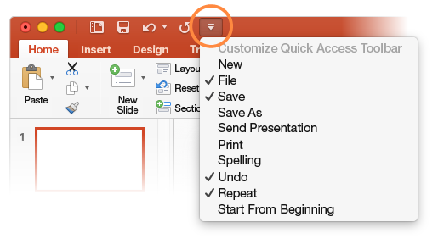
Kompetensi Dasar Dan Tujuan Pembelajaran
At the top of your document, the Quick Access Toolbar puts the commands you use frequently just one click away.
If the commands currently shown aren’t quite what you need, customize the Quick Access Toolbar.
Try it:
Select Customize Quick Access Toolbar and select command names to add or remove them from the Quick Access Toolbar.

Slide 3
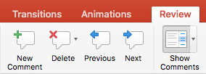
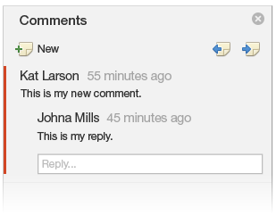

Tools Yang di gunakan
Comments are organized as conversations, so you can easily discuss what's on a slide. This is a great way to quickly add your feedback.
Try it:
Select somewhere in this paragraph, and then select the Review tab.
Select New Comment and type something.
Select Reply, and type something.
Hint: If you want a quick way to see comments in presentations, just select Comments in the Status Bar at the bottom of the screen.

Slide 4
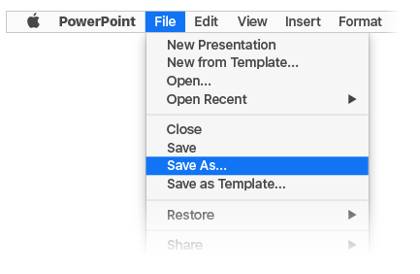
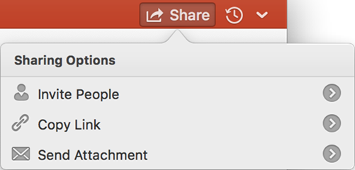
Materi Dan Sumber Belajar
With your document stored online, your group can work on it together at the same time.
How it works:
Select File > Save As to save your document in an online location, like OneDrive.
Select Share from above the ribbon.
Invite people or send a link so they can edit with you.

Slide 5
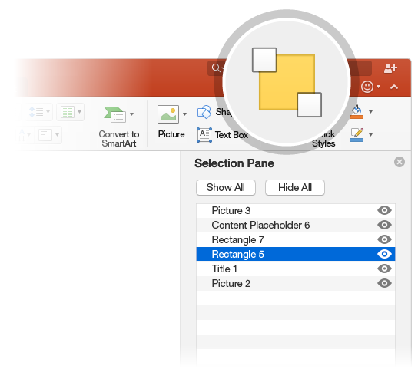

Screenshot Produk/Portofolio
The Selection Pane is a great tool to organize and manage the objects on a slide, such as images, shapes, and text boxes. The Selection Pane is a subscription-only feature. If you have an Office 365 subscription, you can try it yourself:
Try it:
Go to the Home tab, select Arrange > Selection Pane.
Try renaming an object: Double-click the name “Large grey rectangle” in the Selection Pane and type a new name.
Try changing the order of objects: In the Selection Pane, drag and drop the large grey rectangle so it’s at the top.
To toggle visibility of objects in the Selection Pane, click Show/Hide checkbox.

Slide 6

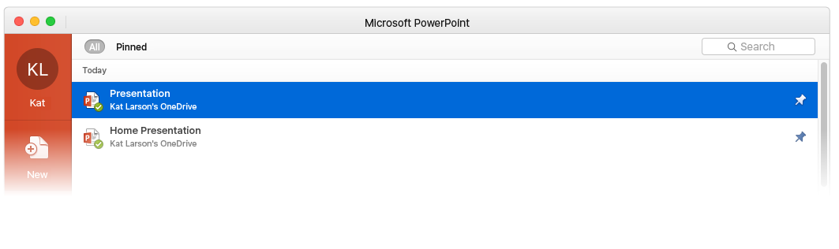

Team Discussion
When you sign in to Office 365, your documents go with you wherever you are. Signing in connects Office to you and to the cloud.
Whenever you launch a program, you’ll see the documents you recently opened on any of your devices.
Got a favorite presentation? Pin it to that first screen you see when you launch an Office program. It remains pinned even when you sign in to Office on another computer.
PowerPoint keeps track of where you left off. The next time you open a presentation, PowerPoint invites you to jump directly to where you were last reading or editing.

Slide 7

More questions about PowerPoint for Mac?
SELECT THE ARROW WHEN IN SLIDE SHOW MODE
Find out more at the PowerPoint for Mac Help Center.
Visit the PowerPoint team blog.
Notes:
In Slide Show mode, select the arrows to visit links.

